Slide 1

Apply Application Promoting Techniques

Slide 2

ABSTRACT
The aim is to study the current application market trends and see how the consumers are using the mobile applications, and how traditional and digital marketing methods can be applied to applications marketing. These methods are also combined to create the most optimal way to create a marketing communications plan for the application. The marketing communication plan is divided to prelaunch, launch and after launch activities. These different parts will support the relationship with the launching of the app and its marketing communications. The main goal with the marketing communication plan is to build awareness and create customer engagement through social media and other channels. The method used in this thesis is qualitative. Mostly the method of this thesis is desktop study. Benchmarking was implemented through a case study where a successful app was examined. The marketing strategy of the case app was used to get ideas in the marketing plan. Mainly the plan was focusing on using marketing tools and social media channels to gain awareness and customer engagement, and to create a guideline how to start.

Slide 3
Index
Introduction
Ranking
Strategies for Marketing
Types of Strategies
Commandments
Conclusion

Slide 4
Introduction:
Application stores offer different kinds of applications, such as games, entertainment or applications with information. As the application market is constantly growing, the new apps have difficulties to stand out and get found on the app stores. Planning includes making a research on the current markets and application trends, defining target audience and creating a marketing communications plan. In applications marketing the activities done before the launch are important where the users should have an image and know the application before the launch, because it creates interest towards the application. This can be done by presenting the application to potential users, bloggers, or to authors that write about new technologies and applications. These people could be introduced to the applications by showing previews or asking them to test it. The pre-launch activities can include creating website, accounts on different Social Media channels and creating a newsletter sent by email. The company can have a landing page, which is the page that the consumer sees first after clicking a link. This landing page should have information about the app, for example what are the main features, for which platforms it is available and when it will be published. Launching an application to international markets requires more research than for an app.

Slide 5
How does ranking works?
Ranking is based on the last 3-4 days of downloads, with today’s marketing the most.
Rank
Today’s Download
Yesterday’s Download
Download’s from 2 days
Recent Activity
Recently however, there are whispers that it’s not just all about downloads anymore – that how often your app gets used is factored into your rank as well.
So you need to drive downloads and encourage repeat usage.

Slide 6
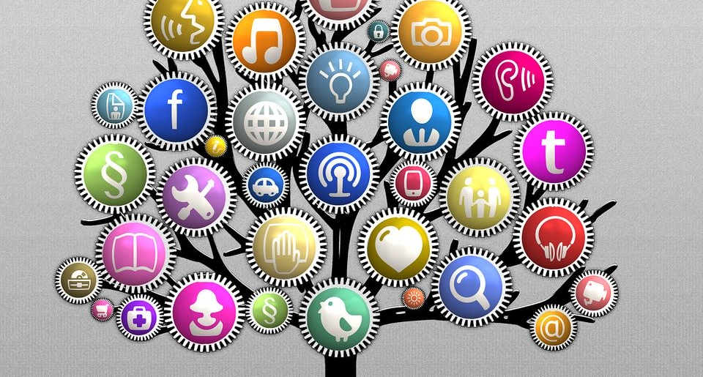
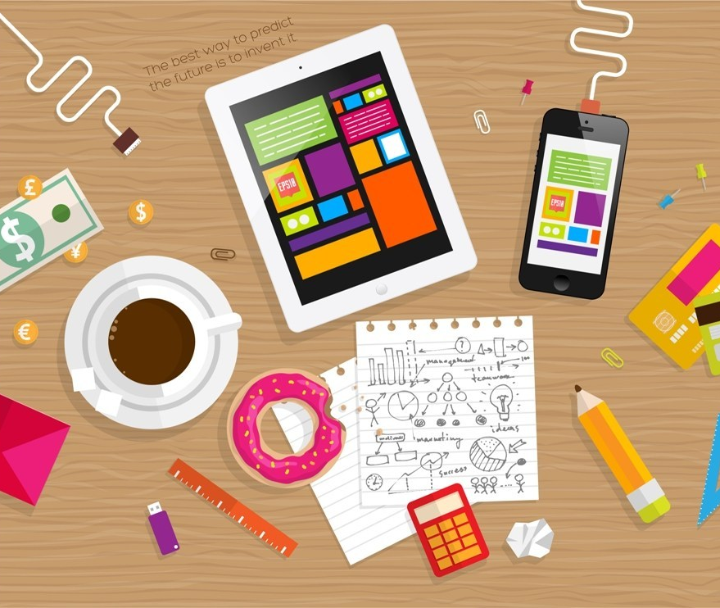
Strategies for App Marketing:
Submission Assets.
Mobile Display.
Mobile Search.
Seeding & PR.
Affiliate Marketing.
Earned Media.
The Social Grid.
Leverage Existing Channels & App Reviews.
Reward Loyalty, Stay Visible.
Measure and Refine & Upgrade.
The Missing ingredient.
This Photo by Unknown Author is licensed under CC BY-SA

Slide 7

Submitting Your Content to Assets Store:
Whether you’re a programmer, game designer, texture artist or 3D modeler, you’re welcome to share your creations with everybody in the Unity developer community. All you need to do is submit your content to asset store. Once your submission is reviewed, you are free to set your own price for the asset. There are few steps to follow how to upload your project on Assets, Therefore:-
Create your Publisher Account.
Upload the assets into packages.
Finalize the package details.
Submit the package to approval.
View the status of your Asset Store Submission.
Once your package is on the Asset Store, take these actions to improve discoverability and encourage customers to purchase your package.
Add tags to your package: To make it easier for your customers to find it.
Connecting your account to Google Analytics: To track website traffic to your package page on the Asset store.
Unity might offer you the chance to include your package in an Asset Store sales promotion. You can either participate in Unity’s sales promotion or set up one of your own.
Authorize Unity to refund your customers for a package.

Slide 8
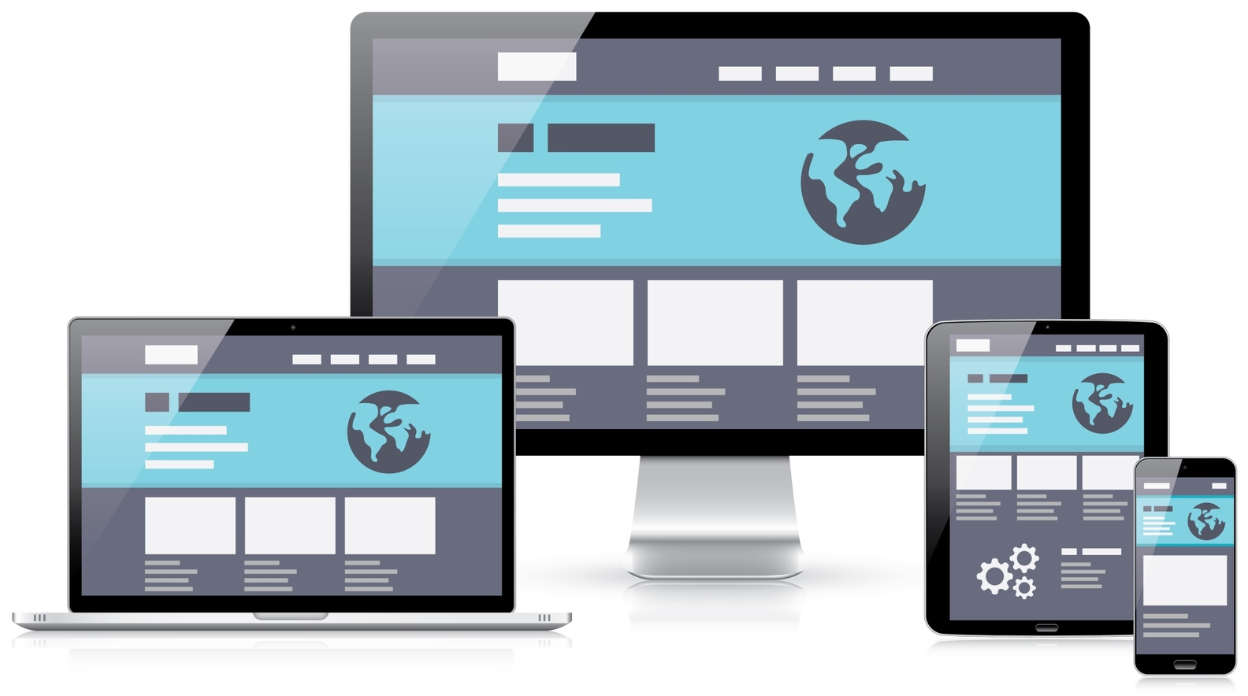
Mobile Display:
What is mobile display? Most of the people doesn’t know how it works. So where the ads are setup to appear on the user’s mobile devices based on their location. For instance, there are the advertisers who want their ads to be displayed when someone enters the area where their business is located within a specific radius.
This Photo by Unknown Author is licensed under CC BY-ND

Slide 9
Mobile Search:
Target Audience for your service.
Incorporate offers or coupons to incentivize click through.
Consult experts with your ad network.

Slide 10
Seeding & PR:
Find influencers in your app’s category or industry.
Food/ Fashion/ Lifestyle/ Gaming is especially relevant here – a galaxy of blogs / influencers.
Offer pre-release copies of the app for review – build buzz to release, like a movie.
Get your PR agency involved – engage trade media as well as consumer media depending on brand.
This Photo by Unknown Author is licensed under CC BY-ND

Slide 11
Affiliate Marketing:
Consider partnering with complimentary brands to promote your app for mutual gain (co-branded offers).
Group Buying platforms.

Slide 12
Earned Media – forums and App reviews:
Submit app to App review sites & online forums:
148apps.com
MliPadApps.com
TheDailyAppShow
theiPhoneAppReview
AppRater
Apptism
FreshApps
Offer Previews / pre-releases.
Create an app video showcase for ease of sharing.
This Photo by Unknown Author is licensed under CC BY-ND

Slide 13
Using the Social Grid:
Promote the App via your brand’s Facebook / twitter profile.
Integrate social sharing within the app, adding incentives where possible.
Create a video showreel of the app on YouTube / Vimeo and promote it via FB / Twitter.
This Photo by Unknown Author is licensed under CC BY-ND

Slide 14
Leverage Existing Channels:
Promote the app to your customer base using all existing channels – Website, EDM, Direct Mails, SMS, etc.
Facebook, Twitter, YouTube Channel.
Even more options available for service extension apps (statements etc.)
This Photo by Unknown Author is licensed under CC BY-ND

Slide 15
Incentivize and reward loyalty:
Is there something you can offer?
Build progressive achievement and incentives into app.
Build in notifications ad alerts into the app where possible / useful to the user.
This Photo by Unknown Author is licensed under CC BY-ND

Slide 16
Measure, Refine and Upgrade:
Analyze which mechanics work best.
Tweak and upgrade the App periodically.
This Photo by Unknown Author is licensed under CC BY-ND

Slide 17
The Missing Ingredient…. HUH?

Slide 18
The missing Ingredient…. HUH?
Build An Awesome App!!! ;-)

Slide 19
Commandments for making a great app:
Make it unique or make it better.
Select a good name.
Find your competitor.
Create an attractive Icon
Will it work in the real world?
Is it a Joy to use?
How will people share it?
What will the haters say?
Plan to promote it.
Plan to support it.
This Photo by Unknown Author is licensed under CC BY-ND

Slide 20
Conclusion:
Smartphones have become a great resource for mobile app marketing. However, the web still matters a lot, and it play a vital role in the growth of business. With the above-mentioned points it is clear that mobile app marketing requires great efforts and time but if the marketing strategies are planned and executed properly, your app can achieve the top rank on app store.

Slide 21


